Slide 1

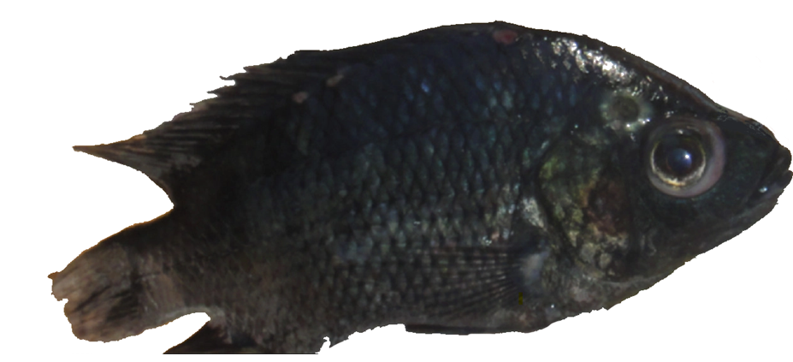
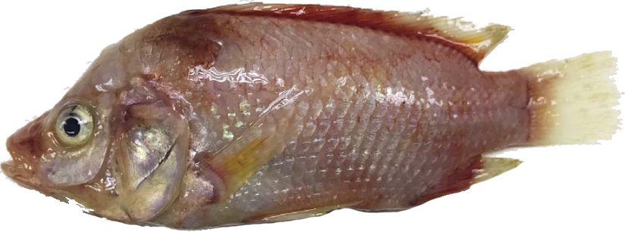
Systemic and mucosal immune response of Nile tilapia broodstock to monovalent and bivalent vaccines against bacteria Streptococcus agalactiae and Aeromonas veronii.
MASTER RESEARCH PROJECT PROPOSAL
Quentin ANDRES
MSc. Aquaculture and Aquatic Resources Management @Asian Institute of Technology, Pathum Thani, Thailand
August 2021
Notes:
Photo on the left from: https://onlinelibrary.wiley.com/doi/abs/10.1111/jfd.12493
Photo on the right: google photos, unspecified.

Slide 2
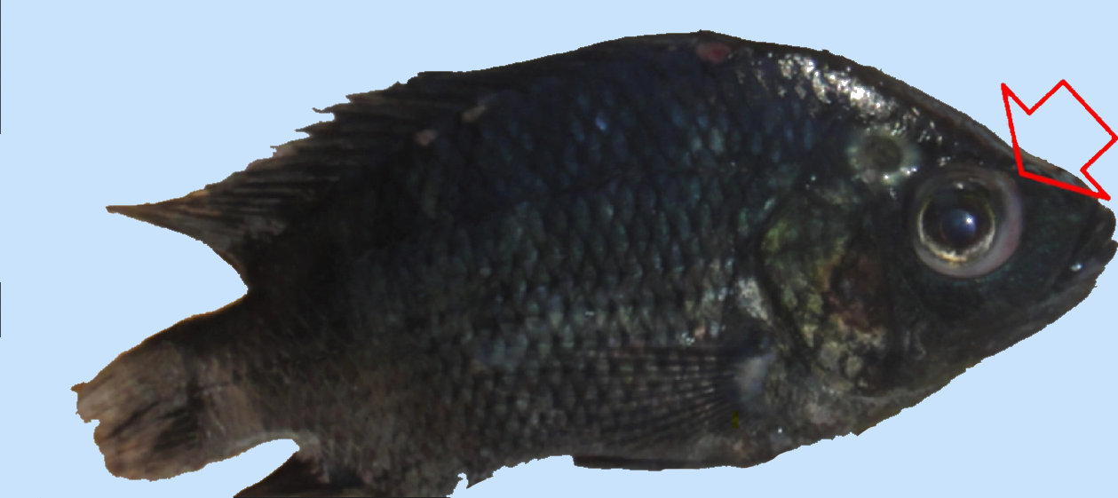
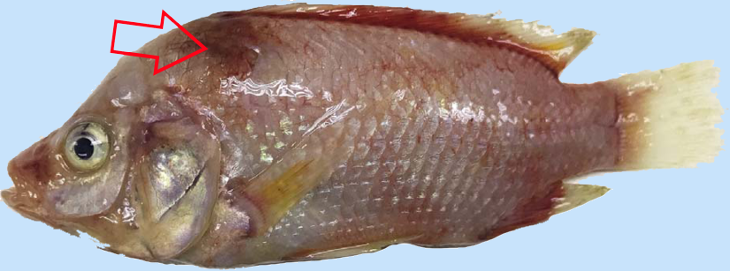
Nile tilapia Aeromonas veronii / Streptococcus agalactiae infection
(Left) Red hybrid tilapia juvenile that positive to TiLV and Aeromonas veronii showing
skin redness and hemorrhages around the operculum area, body and base of dorsal,
caudal and anal fins.
(Right) Black Nile tilapia displaying exophthalmia (pop-eye) and corneal opacity after infection with Streptococcus agalactiae.

Slide 3
Executive summary
There is currently no vaccine against the 2 pathogens available to farmers in Thailand.
Several disease outbreaks have been reported in the past, mostly during hot seasons and after the diminution of DO in the water.
This research project aims to characterize the immune response of the Nile tilapia to inactivated vaccines for the 2 pathogens:
The production of at least 3 vaccines (2 monovalent, 1 bivalent)
Assessment of vaccine efficiency in juveniles and in chiltralada 4 broodstock
A vaccine efficacy-indicating study for Tilapia will be held and results published.

Slide 4
Building the research project
Initiation
Review existing literature on vaccination using inactivated vaccines and antibody response and immunology of cichlids.
Planning
Breakdown of project work in phases, define milestones and deliverables
Executing
Write master thesis
Prepare materials list (fish, vaccine sample, raw material for vaccine production)
Protocols writing for vaccine development, ELISA/PCRs and challenge tests
Execution of the challenge tests and conclude on vaccine efficacy
Husbandry and pond preparation
Closing
Publish one article in aquaculture journals
Define methodology to be used during each project phase
Lab facilities access if external to AIT (SSRU, Mahidol Centex Shrimp)
Conceptualization : ideas; formulation or evolution of overarching research goals and aims.
Project administration : management and coordination responsibility for the research activity planning and execution.
Funding acquisition : acquisition of the financial support for the project leading to this publication.
Monitoring fish immune response after vaccination
Bi-weekly progress report

Slide 5
Research project high level schedule
AUGUST
SEPT
OCTOBER
NOV
DECEMBER
JAN
FEBRUARY
MARCH
APRIL
MAY
Bibliography
Production of Inactivated vaccine
Conceptualization &
Methodology
Write protocols
Inactivated vaccine inoculation (1,2,3 doses)
Immune response (antibody response) of the fish via ELISA, PCR..
Challenge test and result analysis
Get material set up
Data Curation
Writing - Original Draft
Final draft- Preprint
SEPT w1
SEPT w2
SEPT w3
SEPT w4
OCT w1,2
OCT w3,4
NOV
DECEMBER
JAN w1-2
Fish culture (Broodstock in the main pond; Volume = 10.000 Liters)
Production of Inactivated vaccine
Production of juveniles by broodstock strain Chiltralada IV (Size 60 to 90 grams)
Acclimatation of the juveniles (12 days)
Inactivated vaccine inoculation (1,2,3 doses)
Immune response (antibody response) of the fish via ELISA, PCR..
Challenge test
Transfer of juveniles into 4 ponds for the experimentation

Slide 6
Project organization and funding
Project organization
Project fundings

Slide 7
Roadmap
Project organization
Project fundings

Slide 8
Work package - 0
Experimental design discussions
Preparation of metadata

Slide 9
Work package – 1 – Pond preparation
Inspect and clean ponds
Fill pond and prepare feed schedule
Stock brooders

Slide 10
Work package – 2 – Pond preparation
Inspect and clean ponds
Fill pond and prepare feed schedule
Stock brooders

Slide 11
Relevant bibliography

Slide 12
Thank you !

